Slide 1
Microservice architecture benefits
Scale Independently
Different Technology Stacks
Photo Share Service
Thumbnail Service
Photo Share Service node.js
Thumbnail Service .NET
Photo Share Service
Thumbnail Service
Photo Share Service
Thumbnail Service
Photo Share Service
Independent Deployments
Photo Share Service V1
Thumbnail Service V1
Thumbnail Service V2
http://aka.ms/servicefabricvideo to understand microservices

Slide 2
Microservices platform
Build applications with multiple frameworks, containers and languages
Microservices Platform
Deploy and manage applications to many environments

Slide 3

Service Fabric makes it easy
Rolling Upgrades
Availability Guarantees
Scale Out Architecture
Resource Governance
Density
Packaging & Deployment
Policy Enforcement
Granular Versioning
Stateful Workloads
Leader Election
Service Fabric
Azure’s Microservices platform

Slide 4
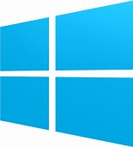


Azure Service Fabric
Any OS, Any Cloud
containers and microservices
Lifecycle
Management
Always On Availability
Programming Models
Health & Monitoring
Dev & Ops Tooling
Auto
scaling
Orchestration
Dev Machine
Azure
On Premise
Infrastructure
Other Clouds

Slide 5




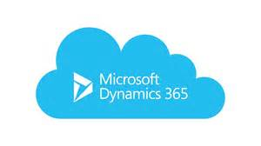

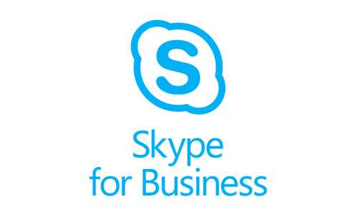

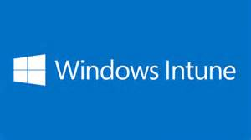
Services Powered by Service Fabric
Cosmos DB
Billions transactions/day
IoT Hub
Millions of messages
Event Hubs
60bn events/day
SQL Database
2.1 million DBs
Skype
Cortana
Intune
Dynamics
Power BI
Designed for mission critical tier 1 workloads
30% of Azure cores run Service Fabric

Slide 6
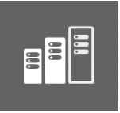
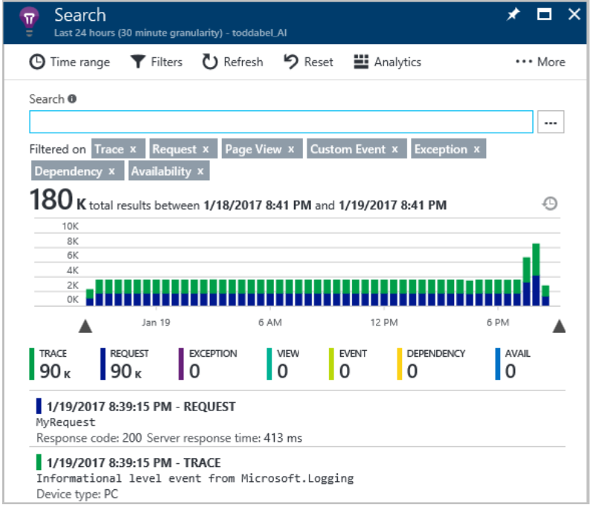
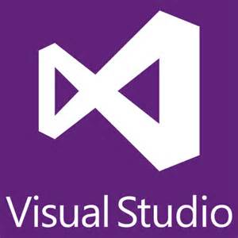
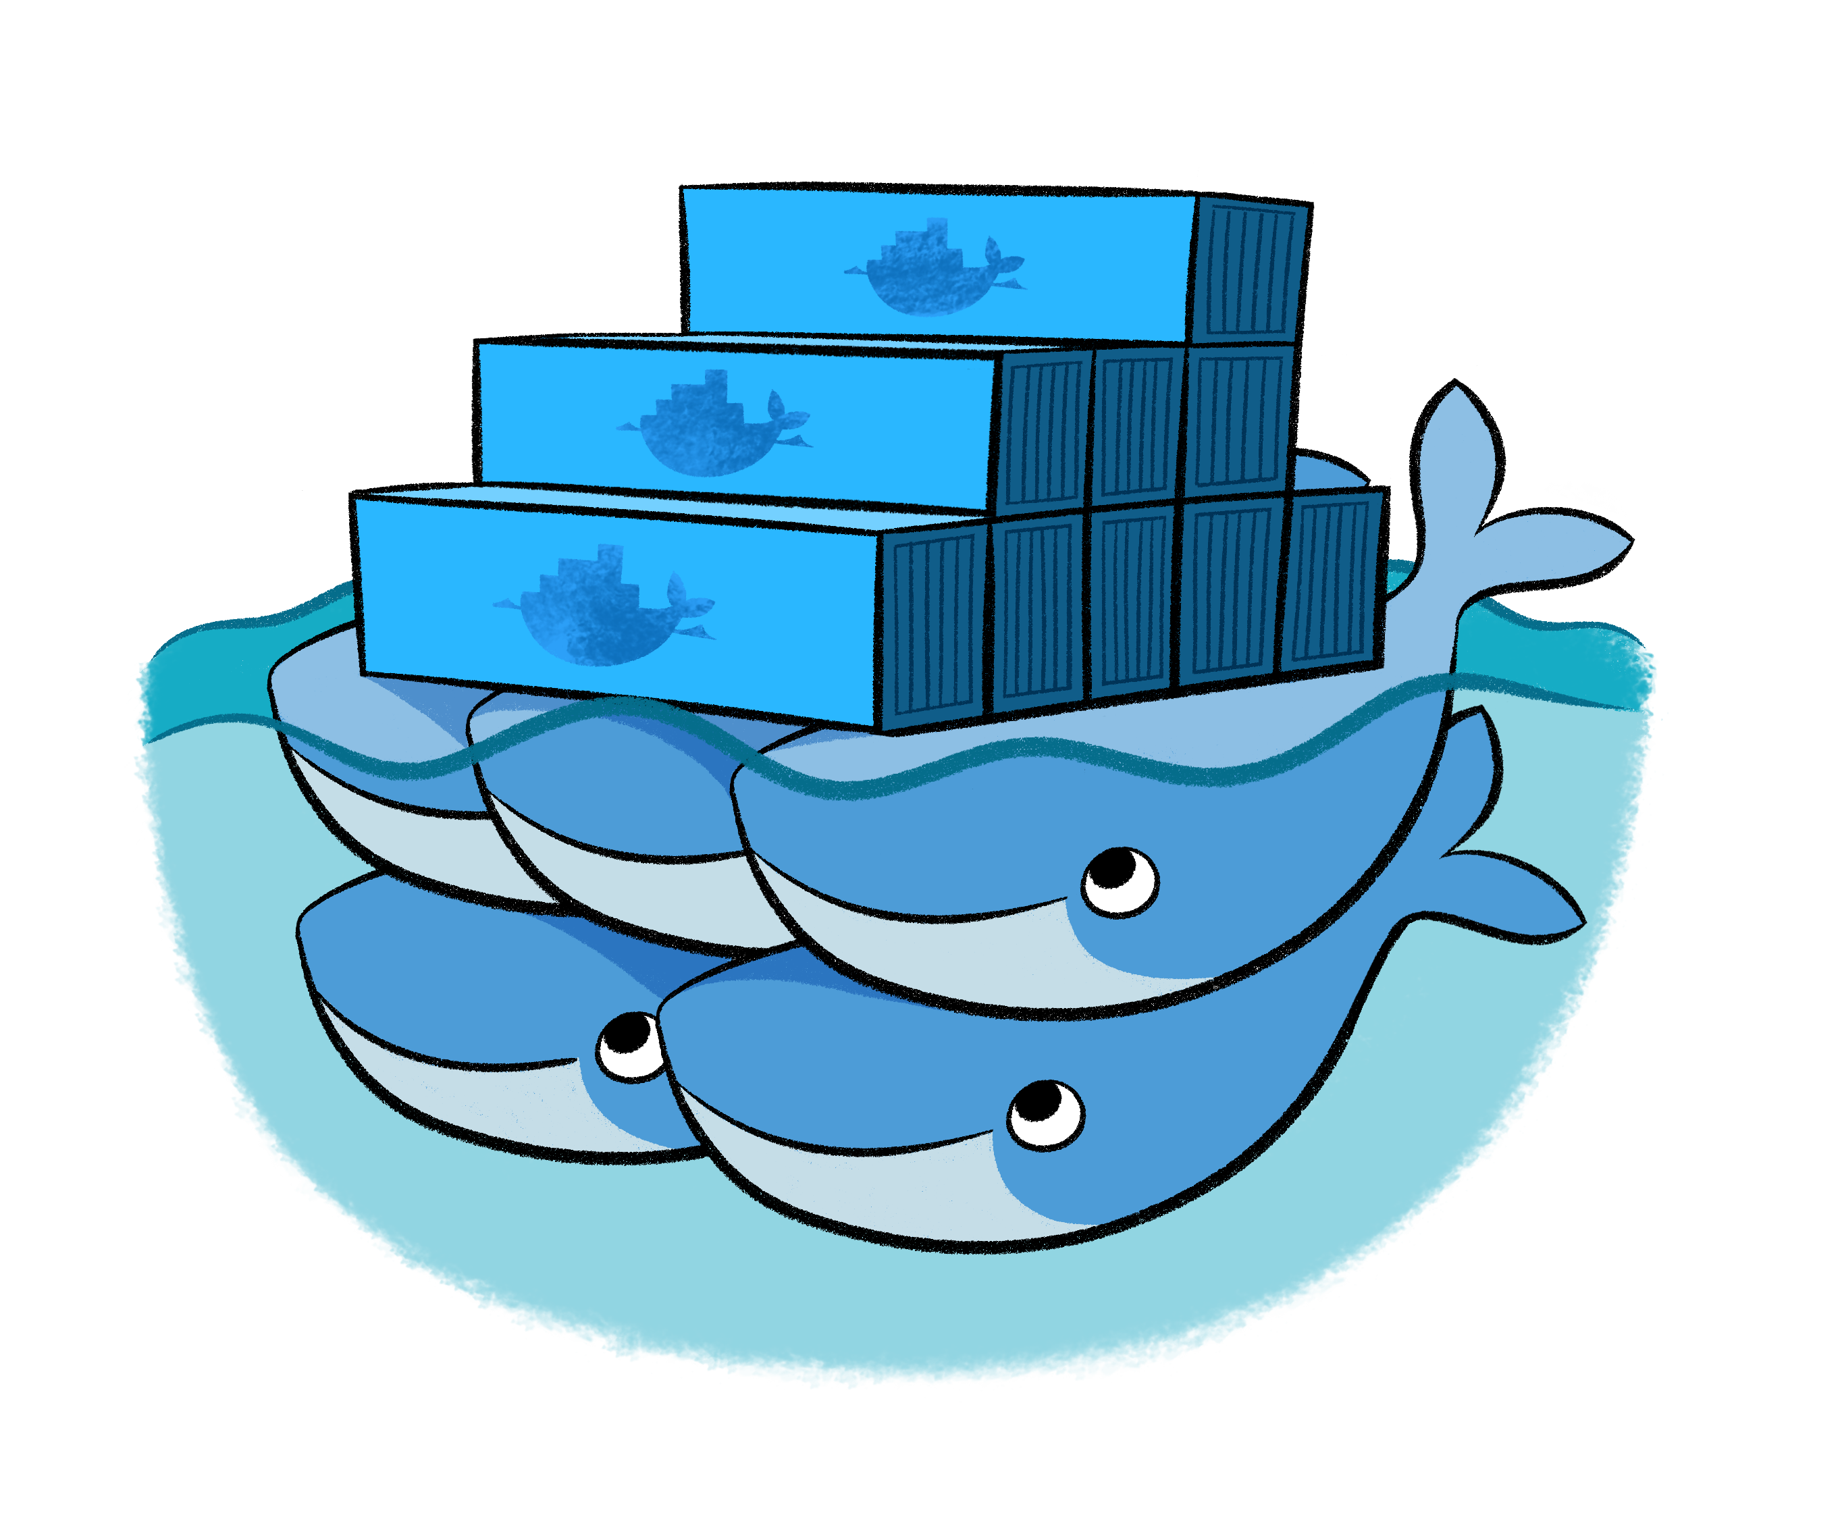
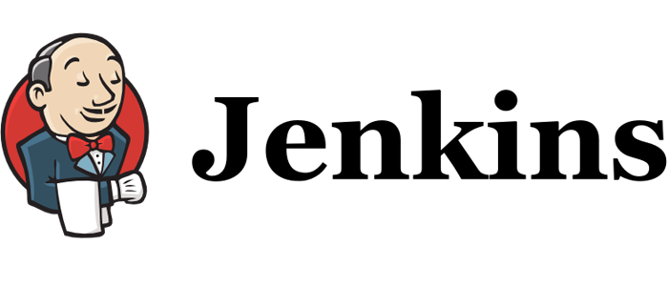

Service Fabric on Azure
Microservices Platform
Managed Service
Productive Development
Automated
platform upgrades
Simple
Programming Models
for. NET, Java
Built-in auto scale
Stateless and Stateful
microservices
Highly scalable
24 X 7 High availability
and failover
Built-in health and diagnostics
Local development
identical to cloud
development
Tooling with Visual Studio, VSTS
Eclipse & Jenkins
Windows and Linux
container
orchestration
DevOps and
Lifecycle management
Integrated with
AppInsights and OMS

Slide 7
Service Fabric on premises
Azure Active Directory
Azure services
Azure
data services
Azure services
Common Identity
Unified Development and DevOps
Consistent Data Platform
Unified Development and DevOps
Active
Directory
On-premises
infrastructure
SQL Server
Azure Stack
Coming Q1 2018

Slide 8
Service Fabric programming models
ASP.NET Core
Reliable Actors
Guest Executables
(Any Code)
Reliable Services
Containers
(Windows containers & Docker)
Lifecycle
Management
Always On Availability
Programming Models
Health & Monitoring
Dev & Ops Tooling
Auto
scaling
Orchestration
On Premise
Infrastructure
Other Clouds
Dev Machine
Azure

Slide 9


CI/CD, diagnostics and monitoring
CI/CD
Visual
Studio/VSTS
ASP.NET Core
Reliable Actors
Guest Executables
(Any Code)
Diagnostics & Monitoring
AppInsights
OMS
ELK
Splunk
Reliable Services
Containers
(Windows Containers & Docker)
Lifecycle
Management
Always On Availability
Orchestration
Programming Models
Health & Monitoring
Dev & Ops Tooling
Auto
scaling
Dev Machine
Azure
On Premise
Infrastructure
Other Clouds

Slide 10

Service Fabric Cluster in Azure
Cluster supports 1,000s of nodes
is self repairing, and scales-in and out
Azure, On-Premises, Other Clouds
PC/VM #2
Service Fabric
Your code, etc.
PC/VM #3
Service Fabric
Your code, etc. (Port: 19080)
PC/VM #1
Your code, etc.
Service Fabric
PC/VM #4
Load Balancer
Your code, etc.
Service Fabric
Your code, etc.
PC/VM #5
Web Request (Port: 80/443/?)
Service Fabric
Your code, etc.

Slide 11
Demo: Creating a cluster Service Fabric on Azure

Slide 12


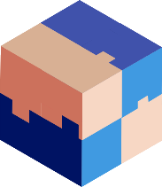



Modernize Applications
Lift & Shift
Modernize
Decompose
Transformed
Traditional application
Hosted as guest executables or containers in Service Fabric
Modernization by adding new microservices
Innovate by decomposing application into microservices
Transformed into microservices or new greenfield application
…You can stop at any stage

Slide 13
Containers and Orchestration

Slide 14

Container Images
Image Contents
Registry
Folders and Files
My Website
Application
HKLM
inetpub
mysite.html
IIS
SOFTWARE/mykey
Application Framework
Image Contents
Registry
Folders and Files
HKLM
HKCU
License.txt
PerfLogs
Program Files
Base Image (OS)
HKCR
HKU
Program Files (x86)
Users
Windows

Slide 15
Service Fabric: Microsoft’s Container Orchestrator
Linux
Linux
Linux
Linux
Linux
Linux
Linux
Linux
Linux
Linux
Linux
Linux
Linux
Linux
Linux
Linux
Linux
Linux
Linux
Linux

Slide 16
Modernize Applications
Lift & Shift
Modernize
Decompose
Transformed
Traditional app
Hosted as guest executables or containers in Service Fabric
Modernization by adding new microservices
Innovate by decomposing application into microservices
Transformed into microservices or new greenfield application
…You can stop at any stage

Slide 17


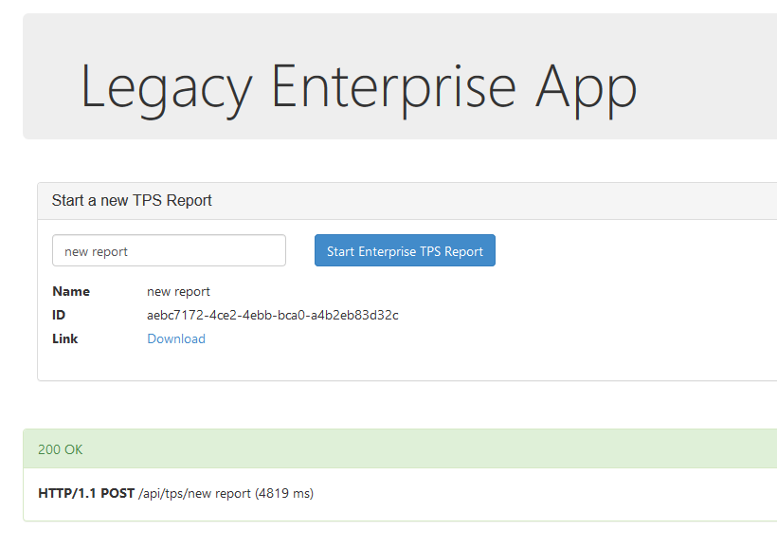


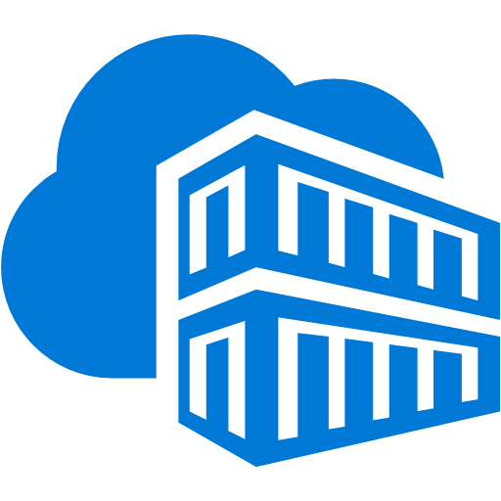
Legacy application: Lift-and-shift
Service Fabric cluster
Docker Compose
Front-end web service
container
Migrate
VSTS Git Repository
Azure Container Registry
SQL Server

Slide 18
Demo: Lift-and-shift
Deploying containers applications to Service Fabric
https://docs.microsoft.com/en-us/azure/service-fabric/service-fabric-host-app-in-a-container

Slide 19
Building Microservice Applications

Slide 20
Migrating a traditional application to microservices
Traditional app
Hosted as guest executables or containers in Service Fabric
Modernization by adding new microservices
Innovate by decomposing application into microservices
Transformed into microservices or new greenfield application
…You can stop at any stage

Slide 21





Stateless Services Pattern
Load Balancer
Load Balancer
Scale stateless services backed by partitioned storage
Increase reliability and ordering with queues
Reduce read latency with caches
Manage your own transactions for state consistency
Front End
(Stateless
Web)
Stateless
Middle-tier
Compute
Cache
Queues Storage

Slide 22

Stateful Services Pattern Simplify design, reduce latency
Load Balancer
Application state resides in the compute tier
Low latency reads and writes
Partitions are first class at the service layer for scale-out
Built in transactions
External stores for exhaust and offline analytics
Front End
(Stateless
Web)
Stateful
Middle-tier
Compute
Cold Data Stores
(Optional)
Selling Point: stateful services are unique to Service Fabric

Slide 23
Demo: Voting application
Building Stateless and Stateful applications
https://docs.microsoft.com/en-us/azure/service-fabric/service-fabric-quickstart-dotnet

Slide 24
Application Upgrade
Upgrade Domain #1
Upgrade Domain #2
Upgrade Domain #3
App Repository
Node
Node
App A v1
Node
App C v2
App A v1
App C v1
Fabric
Node
App B v2
Fabric
Node
Fabric
Node
App B v2
App C v2
App C v1
App C v1
App C v2
Node
Node
Node
Fabric
Node
App B v2
App C v2
App B v2
App C v1
Fabric
Node
App A v1
App A v1
Fabric
Node

Slide 25

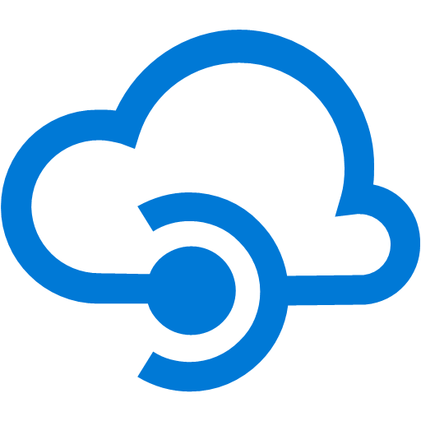
Gateway to your application: lots of options!
stateless web gateway
Service Fabric
Azure Load Balancer
Service Fabric
Azure API Management
IoT Hub
Service Fabric
Service Fabric
Event Hub
Selling Point: Service Fabric integrates with other Azure services

Slide 26
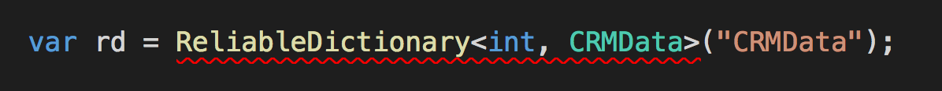
Developer – The Road Ahead
.NET Core for Windows and Linux applications
Simplified data structures can be used with any programming model

Slide 27
To build, deploy, and operate…
…containers or microservices on any OS on any cloud
Programming Models
Dev & Ops Tooling
Orchestration
Lifecycle Management
Health &
Monitoring
Always On Availability
Auto
Scaling
Dev machine
Azure
On-premises infrastructure
Including Azure Stack
Other clouds

Slide 28
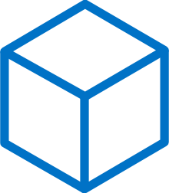
Build: data-aware microservices
Programming Models
Dev & Ops Tooling
Orchestration
Lifecycle Management
Health &
Monitoring
Always On Availability
Auto
Scaling
Lifecycle Management
Always On Availability
Orchestration
Programming
Models
Health &
Monitoring
Dev & Ops
Tooling
Auto
Scaling
</>
Reliable Actors
Reliable Services
Guest Executables
Containers
.NET, or Java
Maximize uptime and scalability with stateful and stateless Actors
Manage state reliability without a database, lowering latency. Use stateless services to write data to eternal data stores
Run any existing code
Orchestrate your Windows Server or Linux containers reliably at scale
Best platform for .NET and ASP.NET core with Visual Studio 2017 and Java using Eclipse and Jenkins

Slide 29
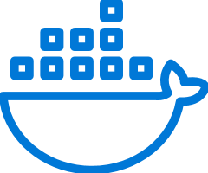


Deploy: any code on any OS
Programming Models
Dev & Ops Tooling
Orchestration
Lifecycle Management
Health &
Monitoring
Always On Availability
Auto
Scaling
Lifecycle Management
Always On Availability
Orchestration
Programming
Models
Health &
Monitoring
Dev & Ops
Tooling
Auto
Scaling
CI/CD
Docker Compose and
Azure Container Instance
Automate
Rolling upgrades
Monitor and diagnose
Use familiar tools: Visual Studio + Team Services for .NET or Jenkins + Yeomen for Java
Deploy or remove applications using PowerShell, CLI, Visual Studio, and other APIs
Upgrade non-disruptively and roll-back in case of failures, automate with PowerShell
Generate, aggregate, and analyze events with built-in tooling and integration with Azure services such as AppInsights and OMS
Orchestrate existing container applications or deploy single containers

Slide 30
Operate: on any cloud at any scale
Programming Models
Dev & Ops Tooling
Orchestration
Lifecycle Management
Health &
Monitoring
Always On Availability
Auto
Scaling
Lifecycle Management
Always On Availability
Orchestration
Programming
Models
Health &
Monitoring
Dev & Ops
Tooling
Auto
Scaling
Use familiar tools
Use controlled chaos
Recover gracefully
Secure at scale
Automated Platform Upgrades
Such as Splunk, OMS, ELK, or AppInsights to gain deep insights or monitor application health
Test graceful and ungraceful failure scenarios
Recover from machine or service failure gracefully; replicate data automatically
Secure node-to-node communication and management access
Service Fabric runtime and OS upgrades are automated for you or can choose to schedule them

Slide 31
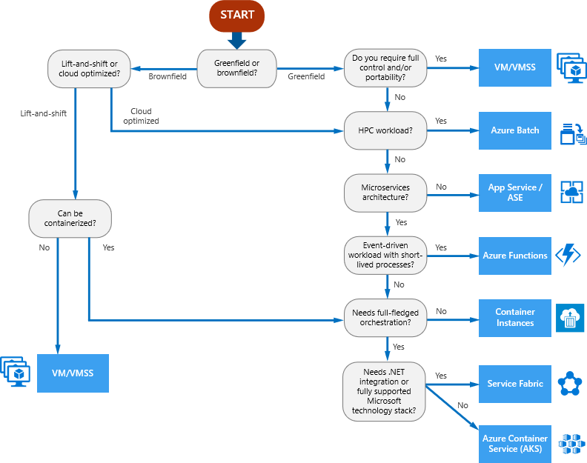
Compute Decision Tree
Compute Services covered:
VM
VMSS
Azure Batch
App Service
App Service Environment
Azure Functions
Container Instances
Service Fabric
Azure Kubernetes Service

Slide 32
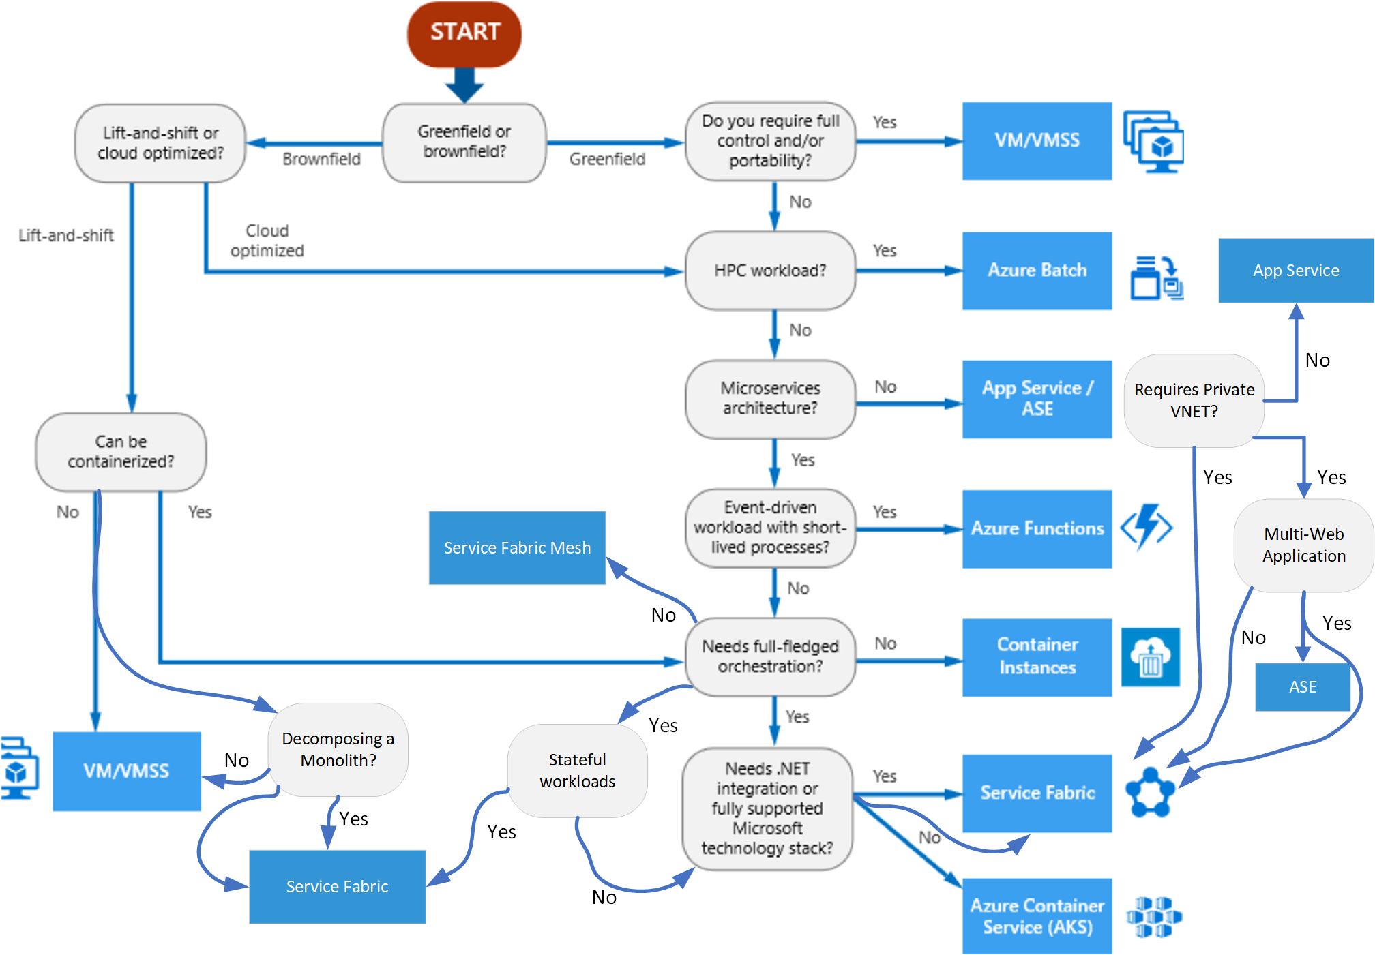
Compute Decision Tree v2

Slide 33
Best Practices

Slide 34
Cloud App Continuum
AI-based apps
Cloud Native
Microservices, Serverless
….
App Modernized
Lift&Shift to PaaS
Cloud Optimized
Lift&Shift to containers
May involve containers
Engineering Complexity and Cost
Lift and Shift
VMs
May involve containers
No code changes
Existing OnPrem Applications
App Modernization
Agility, Time to Market Total Cost of Ownership, IT Simplification

Slide 35

Service Fabric Host Infrastructure
VNET: 10.0.0.0/23
Example network infrastructure for an enterprise deployment
Service Fabric cluster
Application Subnet 10.0.0.0/24
Management Subnet 10.0.1.0/24
Application Node Type – externally exposed subnet
Primary Node Type – isolated internal subnet
Host IP 10.0.0.4
App Host 1
Container
Reverse Proxy: 443
Container A
10.0.0.5
Container C
10.0.0.6
Primary Host 1
Host IP 10.0.1.4
Host IP 10.0.0.7
Primary Host 2
App Host 2
Host IP 10.0.1.5
Container Reverse Proxy: 443
Container B
10.0.0.8
Primary Host 3
Host IP 10.0.1.6
Host IP 10.0.0.9
Primary Host 4
App Host 3
Host IP 10.0.1.7
Container A
10.0.0.10
Primary Host 5
Host IP 10.0.1.8

Slide 36
Infrastructure Best Practices
Use Multiple NodeTypes (VMSS cluster)
2 NodeTypes are ideal
One for Service Fabric Primary services
Two for the application containers
Use Placement Constraints to deploy to the apps NodeType
Ensure enough space on the primary NodeType temp disk
Use a VM compute size with 50 GB of temp disk or more (i.e. Standard_D2_v3)
Use the optimal VMSS Windows Image for each NodeType
i.e. Windows Server 2016 + Containers for apps NodeType
i.e. Windows Server 2016 (no containers) for primary NodeType
<Service Name="ArrSrv" ServicePackageActivationMode="ExclusiveProcess">
<StatelessService ServiceTypeName="ArrSrvType" InstanceCount="[ArrSrv_InstanceCount]">
<SingletonPartition />
<PlacementConstraints>(NodeTypeName==appNT)</PlacementConstraints>
</StatelessService>
</Service>
ApplicationManifest.xml

Slide 37
Infrastructure Best Practices cont.
Ensure container images get trimmed from OS disk
Applies only to App NodeType
{
"name": "Hosting",
"parameters": [
{
"name": "IPProviderEnabled",
"value": "true"
},
{
"name": "PruneContainerImages",
"value": "True"
},
{
"name": "ContainerServiceArguments",
"value": " "
},
]
},
ApplicationManifest.xml

Slide 38
Container Networking Diagram
Client invokes application running in Container A over HTTPS
VNET
Service Fabric cluster
Host IP 10.0.0.4
SF Host 1
ARR
Container
Reverse Proxy: 443
3
Container A
10.0.0.5
Container C
10.0.0.6
1
3
Host IP 10.0.0.7
SF Host 2
ARR
Container Reverse Proxy: 443
Container B
10.0.0.8
3
2
3
2
ARR Reverse Proxy – NAT bridge
Containers A/B/C – open networking
Host IP 10.0.0.9
SF Host 3
Container A
10.0.0.10
SF DNS
Service

Slide 39
Networking Best Practices
If apps need to share the same port (80/443)
Use Open Networking
IP-per-container
Deploy a custom reverse proxy to a container
ARR (Application Request Routing) for URL Rewrite
Needed for Open Networking scenario
Dockerfile available for this container
Leverage the Service Fabric DNS Service
Maps a well known service name to the dynamic IP running the container
<Service Name="app01svc" ServiceDnsName="app01.container.abcxdomain.com">
<StatelessService ServiceTypeName="app01svcType" InstanceCount="[app01svc_InstanceCount]">
</StatelessService>
</Service>
ApplicationManifest.xml

Slide 40
Scaling Best Practices
Use Resource Constraints to optimize container placement
Container Auto-scale
<Policies>
<ContainerHostPolicies CodePackageRef="Code" Isolation="default">
<RepositoryCredentials AccountName="acnsfc" Password="" PasswordEncrypted="false"/>
<NetworkConfig NetworkType="Open"/>
</ContainerHostPolicies>
<ServicePackageResourceGovernancePolicy CpuCores="1" MemoryInMB="1024" />
</Policies>
ApplicationManifest.xml
<Service Name="app01svc" ServiceDnsName="app01.container.abcxdomain.com">
<StatelessService ServiceTypeName="app01svcType" InstanceCount="[app01svc_InstanceCount]">
<ServiceScalingPolicies>
<ScalingPolicy>
<AveragePartitionLoadScalingTrigger MetricName="servicefabric:/_CpuCores" LowerLoadThreshold="0.2" UpperLoadThreshold="0.3" ScaleIntervalInSeconds="600"/>
<InstanceCountScalingMechanism MinInstanceCount="1" MaxInstanceCount="2" ScaleIncrement="1"/>
</ScalingPolicy>
</ServiceScalingPolicies>
</StatelessService>
</Service>
ApplicationManifest.xml

Slide 41
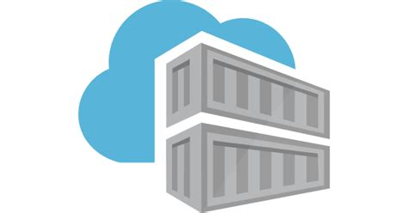

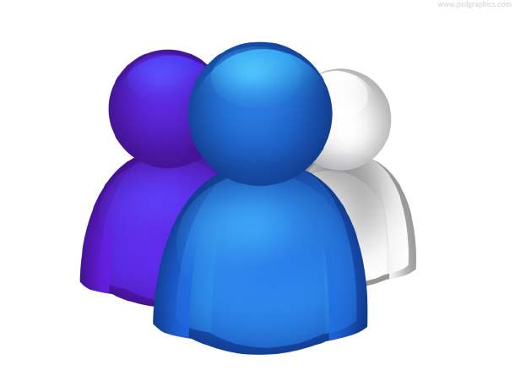



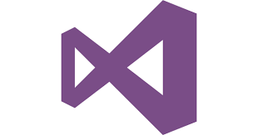
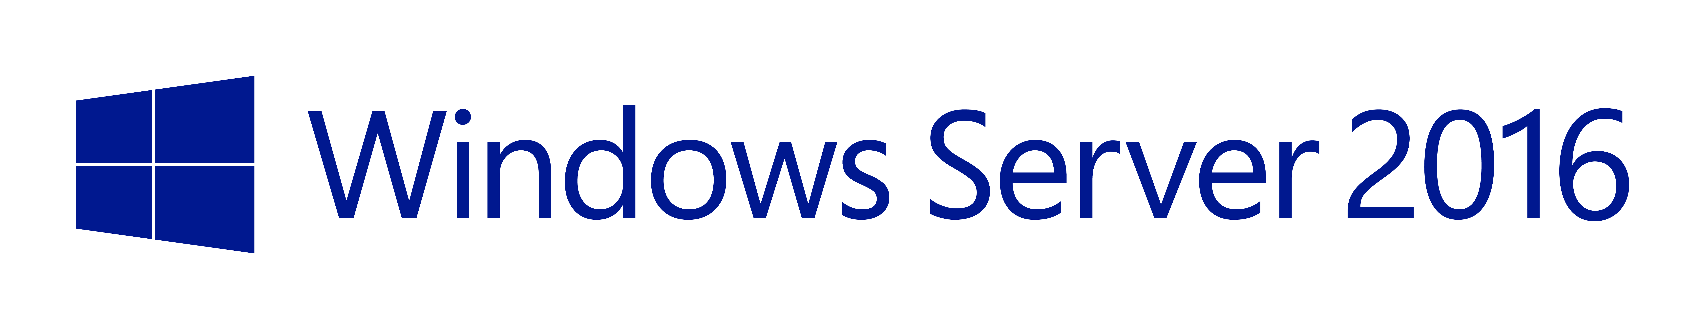
DevOps Lifecycle Example
App Container Registry
Image
Scanning
Security
Developers
Pull
Runtime Scan
Push
Deploy
VSTS
Build/Test
Service Fabric Environments
Monitor
(Log Analytics)
Push
Pull
Container Engineering
Base Image Container Registry
KEY:
Developer
Container Engineering
Security

Slide 42
Security Best Practices
If Windows Integrated Security required…
Use Group Managed Storage Accounts (MSI support coming)
Requires domain joined App NodeType hosts
If not, use Docker Environment Variables to pass secrets to containers
<Policies>
<ContainerHostPolicies CodePackageRef="Code" Isolation="default">
<SecurityOption Value="credentialspec=file://container_gmsa1.json"/>
<NetworkConfig NetworkType="Open"/>
</ContainerHostPolicies>
</Policies>
ApplicationManifest.xml
<CodePackage Name="Code" Version="1.0.0">
<EntryPoint>
<ContainerHost>
<ImageName>acnsfc.azurecr.io/app01:2.2</ImageName>
</ContainerHost>
</EntryPoint>
<EnvironmentVariables>
<EnvironmentVariable Name="databaseconnectionstring" Value="Server=10.0.0.56;Database=Test;User ID=testuser;Password=;Integrated Security=false;MultipleActiveResultSets=True;Connect Timeout=30"/>
<EnvironmentVariable Name="LOGANALYTICS_CONTAINERS_MASK_ENVVAR_VALUE_REGEX_LIST" Value="/database?/,/pass?/"/>
</EnvironmentVariables>
</CodePackage>
ServiceManifest.xml

Slide 43
Security Best Practices cont.
Leverage 3rd Party container image vulnerability scanning
Push/Pull into Azure Container Registry
Two vendors have marketplace products
Aqua Security, Twistlock
Optionally provision on-host container firewall with Aqua/Twistlock
Azure Security Center adding scanning and host firewall features
Linux container support in preview
Windows containers on roadmap
Read cluster template secrets from Key Vault
"VMSS-AdminPassword": {
"reference": {
"keyVault": {
"id": "/subscriptions/…/providers/Microsoft.KeyVault/vaults/vaultname"
},
"secretName": "VM-AdminPassword"
}
},
ARM-template-params.xml

Slide 44
Docker Health Check
Understand Service Fabric Health Monitoring
https://docs.microsoft.com/en-us/azure/service-fabric/service-fabric-health-introduction
Plug into health monitoring with Docker Health Checks
FROM enttest.azurecr.io/windowsservercoreweb:1.43
SHELL ["powershell", "-Command", "$ErrorActionPreference = 'Stop'; $ProgressPreference = 'SilentlyContinue';"]
RUN New-Item -ItemType Directory C:\inetpub\wwwroot\AppDir;
COPY ./healthcheck.bat C:\install
COPY ./install-website.ps1 C:\install
COPY ./wildcard.pfx C:\install
COPY ./PublishOutput /inetpub/wwwroot/AppDir
# The install-website will remove the Default site and create App website on inetpub\wwwroot, and install wildcard cert
RUN C:\install\install-website.ps1
HEALTHCHECK --interval=30s --timeout=30s --start-period=60s --retries=3 CMD C:\install\healthcheck.bat
App Dockerfile
C:\curl.exe --fail http://localhost || exit 1
Healthcheck.bat

Slide 45
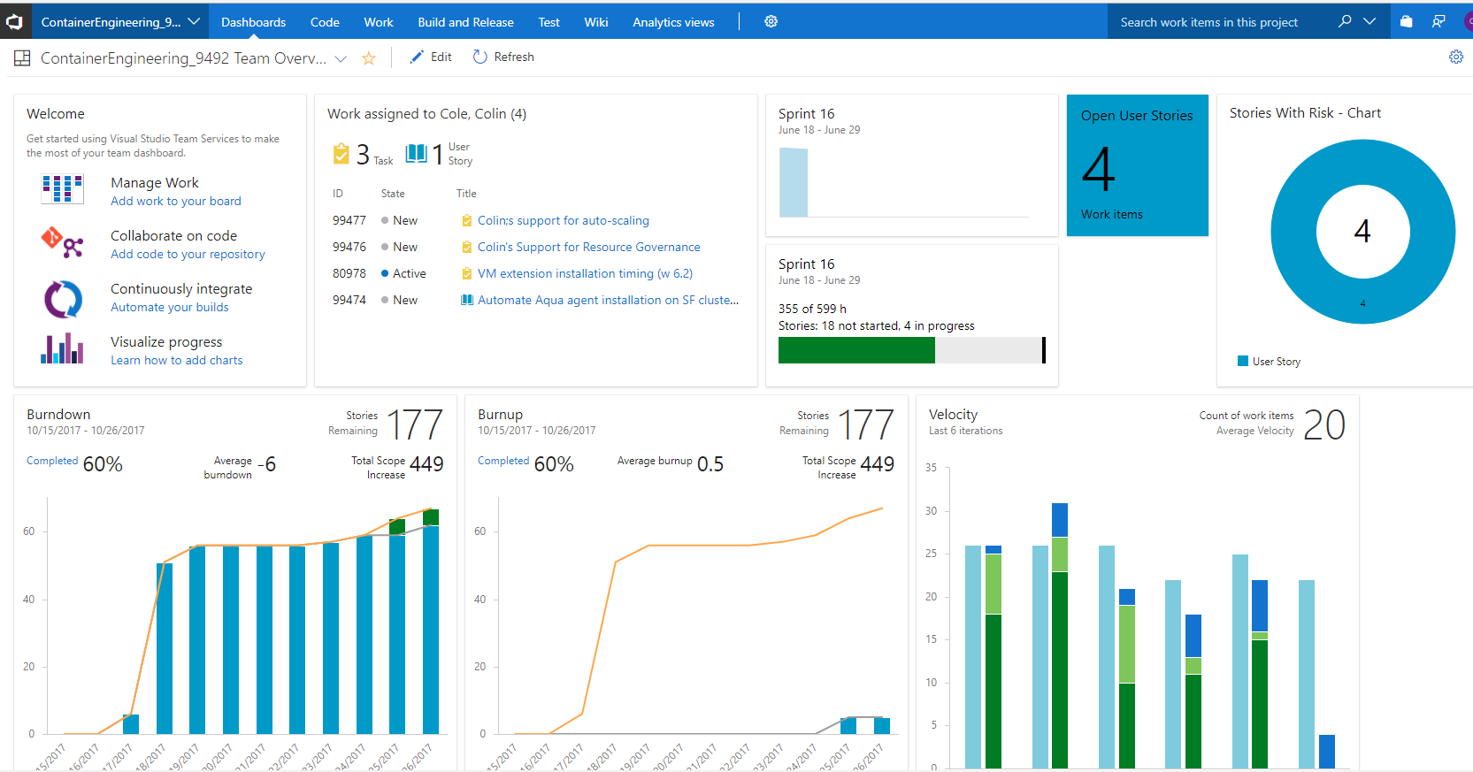

Slide 46
Reusable Assets -- GitHub
https://github.com/colincole/ServiceFabricContainers
White Paper
Containerizing Enterprise Applications With Azure Service Fabric
Enterprise cluster ARM template
Multiple nodetypes, open networking monitoring, KeyVault integration, etc.
Reverse Proxy using ARR (Application Request Routing)
dockerfile and scripts

